Slide 1

Welcome freshers!

Slide 2
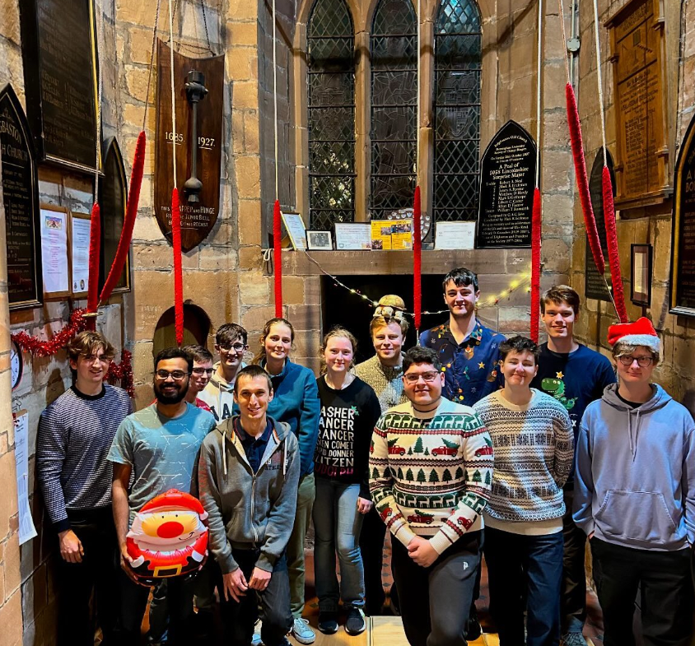
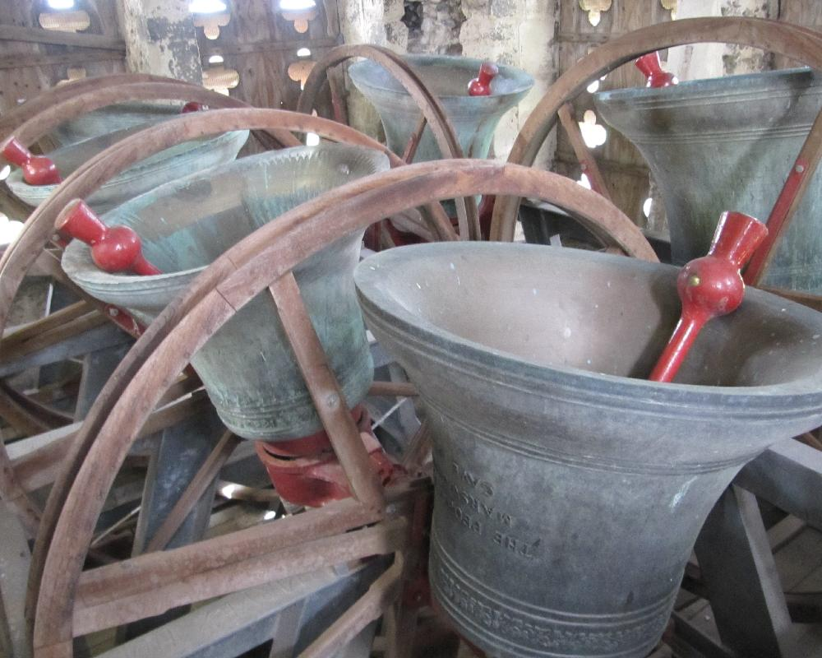
Who are we?
We are the university student church tower bell ringers in Birmingham (the elite of the elite)
We welcome all new members, whether you’ve never touched a rope before or have been ringing for years

Slide 3
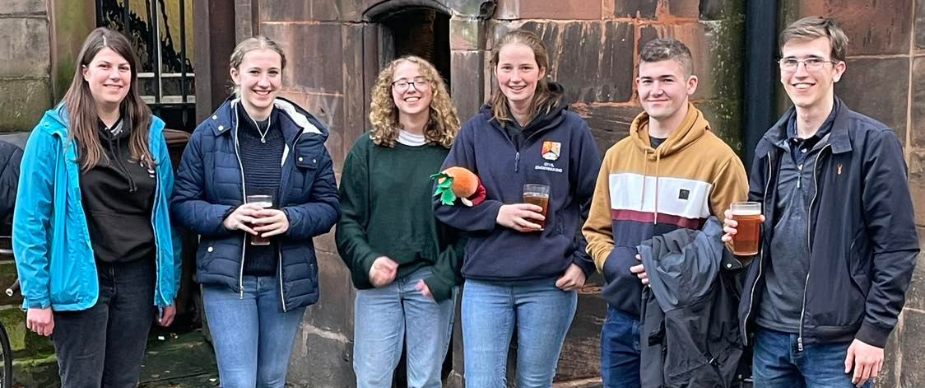
What do we do?
Quite a bit of bells. We have a weekly practice (followed
by pub), day trips out and frequent other ringing.
ALSO: Pub, Annual formal dinner, socials (quiz & curry)
Check out our posts from last year to see what we got up to!

Slide 4
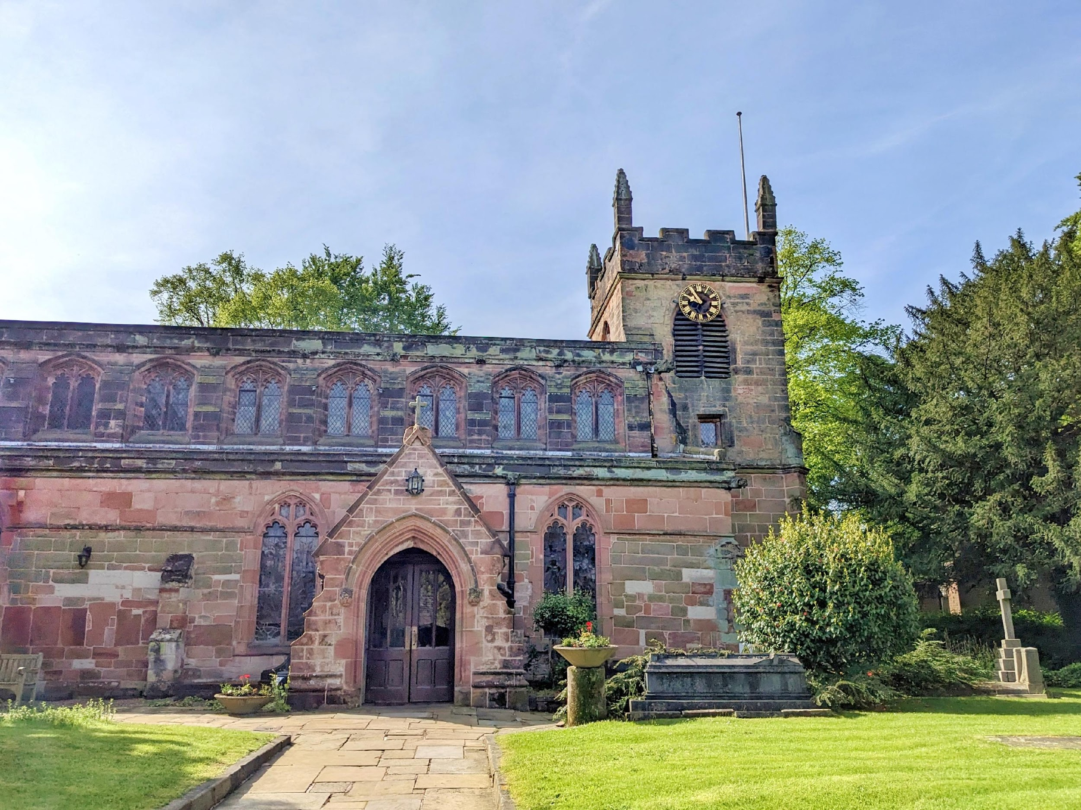
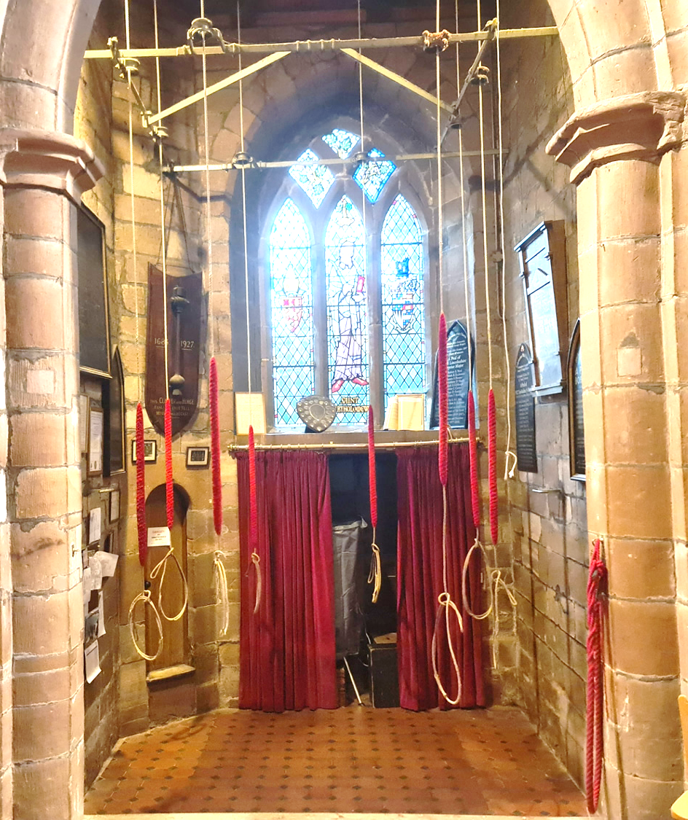
Where?
Edgbaston Old Church St Bartholomew
///short.people.barn
(Right next to The Vale)
Where you WILL come in
Very easy to get to from city centre or Selly via the X21/X22 bus stop right outside
Five Ways station is a 15min walk down the road

Slide 5
When?
Every Friday – Students practice
19:00-19:30 Handbells
19:30-21:00 Tower bells (with cake break)
21:00- Pub
Every other day
Although Friday is the main students practice quite a lot of us attend other practices in the city centre and suburbs throughout the week

Slide 6
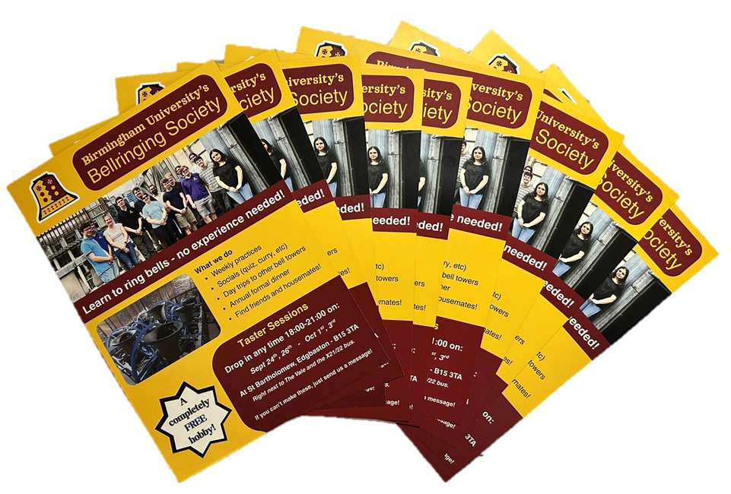
Taster Sessions
If any of this sounds interesting, we are running 4 give it a go tower tour sessions, checkout the taster sessions post for more info!
Don’t worry if you can’t make them, just send us a message.

Slide 7



JOIN US!
You DON’T need to be
Religious
Musical
Strong
Just keen to learn something new and different
Drop us a message
Birmingham_Uni_Bells (here)
07821 726903
buscr.committee@gmail.com

Slide 9
Taster Sessions
Curious what we get up to?
We are hosting some tower tours and give it a go sessions over the next couple of weeks

Slide 10
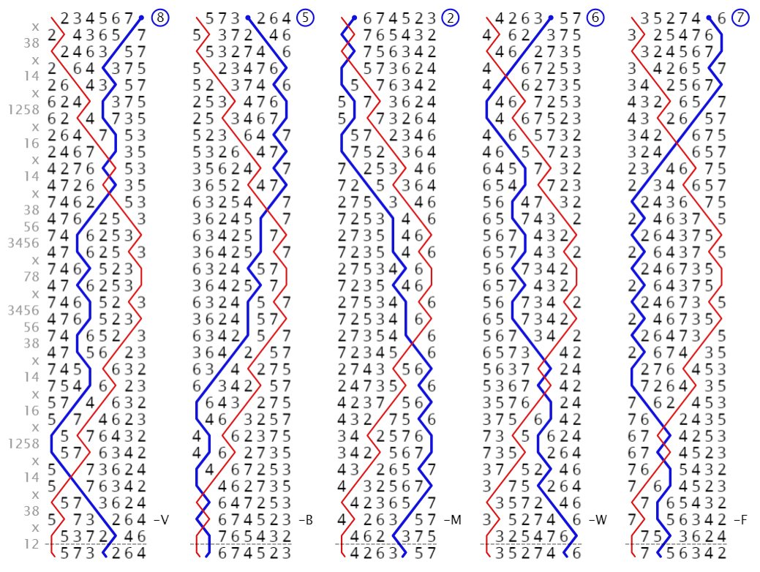
What?
Our student band will:
Show you up the tower to see our 8 bells, weighing in at over 2500kg
Take you to the tower roof for quite the view
(Provide Brownies)
Demonstrate change ringing (the different mathematical patterns)
Give you a go ringing one of our bells
Have a good social meet!

Slide 11

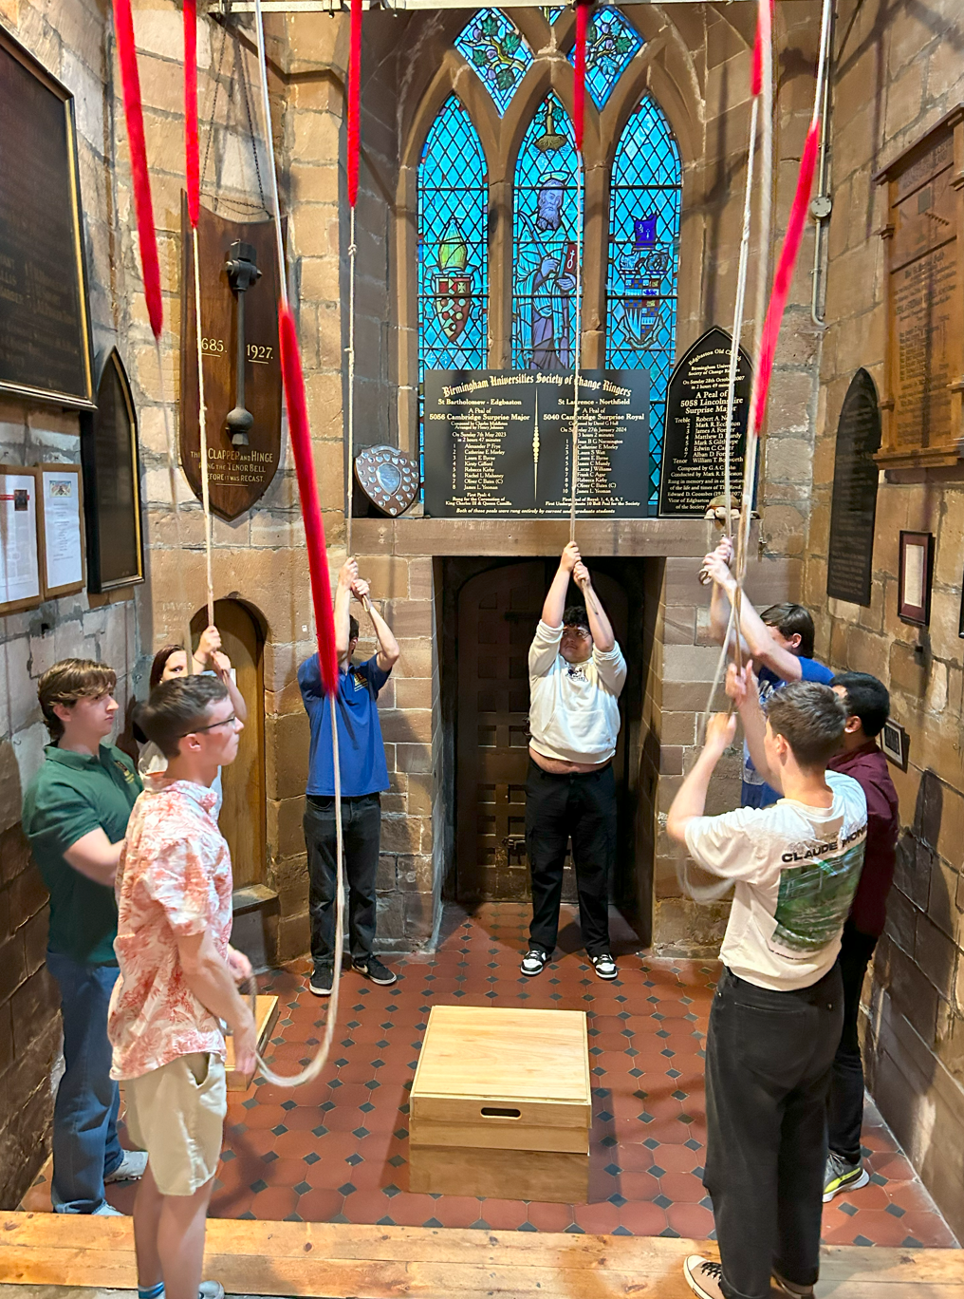
Where?
Edgbaston Old Church, St Bartholomew
(Right next to The Vale)
We are not religious!!!
Easy to get to from the city centre or Selly via the X20/21/22 bus stop (Aston House) right outside

Slide 12
When?
A team of us will be there to show you around and give you a go on:
Wednesday 24th
Friday 26th
Wednesday 1st
Friday 3rd
Drop in for a 15min tour anytime 18:00-21:00
Just turn up when you can! All the sessions will be followed by a trip to the pub for those interested.
If you can’t make them, no worries, just drop us a message and we will be happy to welcome you at our usual practices.

Slide 13
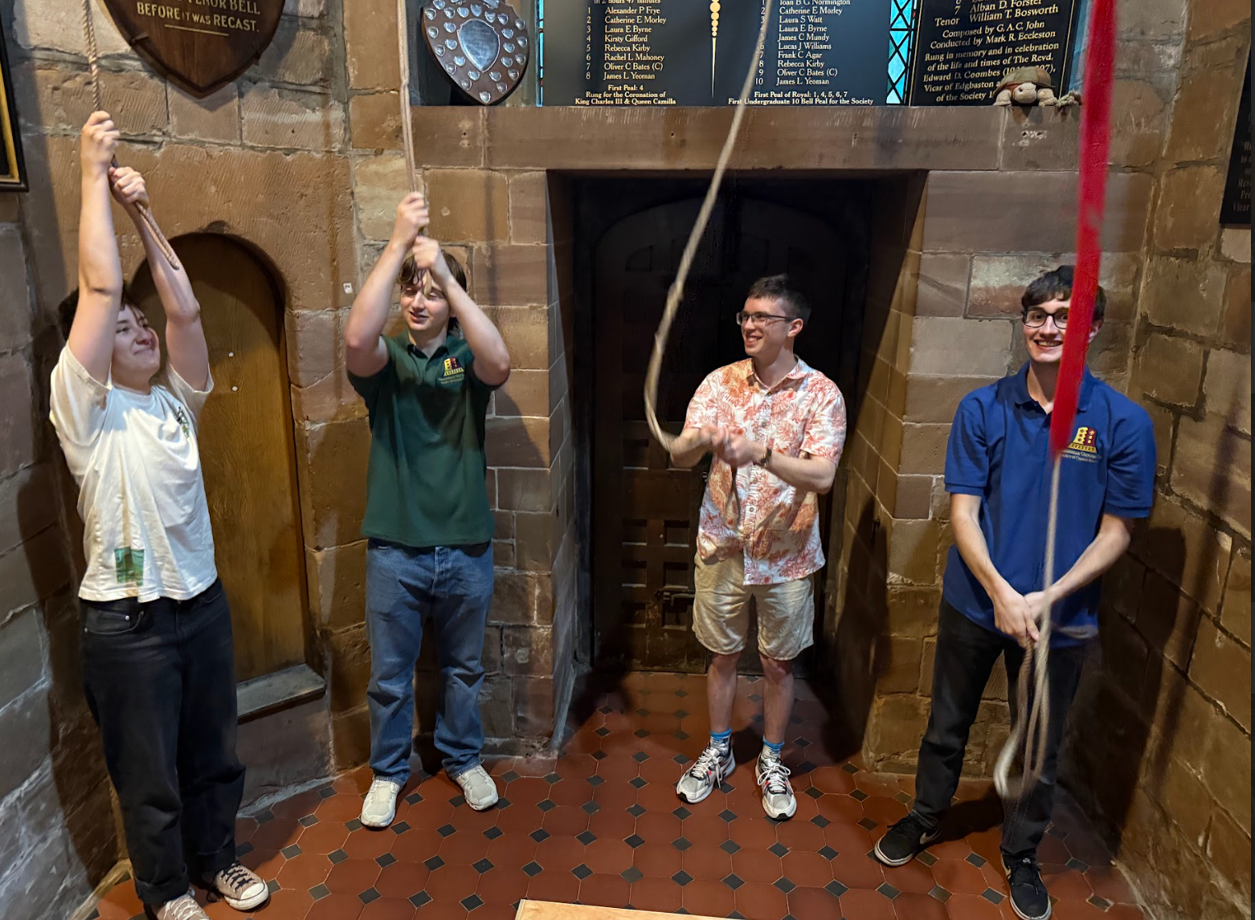
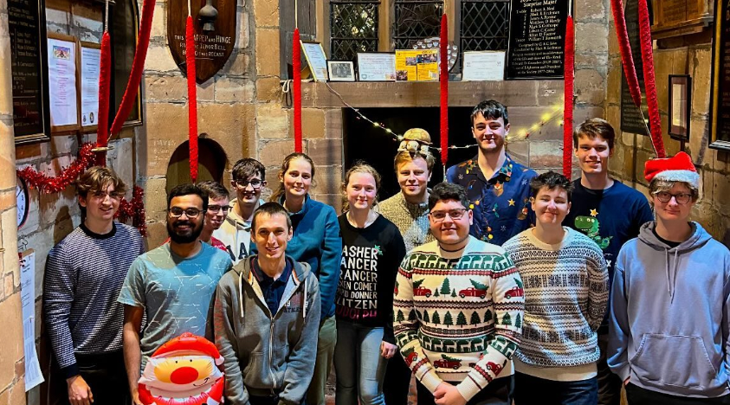
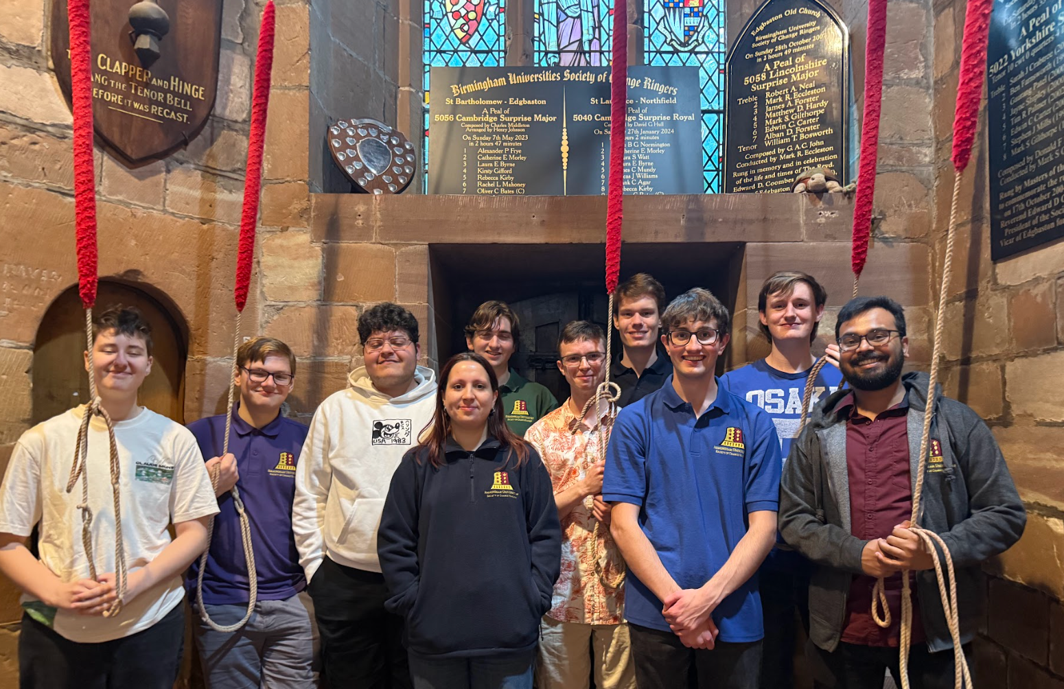
Why?
You might find something you truly enjoy. If it's not for you, no worries - there's absolutely no pressure to return. Plus, you've had a chance to get a behind-the-scenes look at a pretty cool building and activity!
Nothing to lose really…

